Slide 1
PSCS_531_Projection of the extent of inundation corresponding to the forecasts of flood levels in a river.
CSE7101- Capstone Project
Review-3
Batch Number: CSE_131
Roll Number | Student Name
HARSHITHA A Y | 20221CSE0526
HAMSA M | 20221CSE0525
BHAGYASHREE N PATIL | 20221CSE0499
Under the Supervision of,
Mr.Likhith S.R
Professor-School of Computer Science and Engineering
Presidency University
Name of the Program: CSE
Name of the HoD: Dr. Asif Mohamed H B
Name of the Program Project Coordinator: Dr. Jayavadivel Ravi
Name of the School Project Coordinators: Dr. Sampath A K , Dr. Geetha A

Slide 2
Content
Problem Statement
Abstract
Literature Survey
Objectives
Data Sources
Architecture Diagram
Modules
Hardware and Software Details
Timeline of the Project (Gantt Chart)
References

Slide 3
Problem Statement Number: PSCS_6
Organization : Department of Computer Science and Engineering,
Presidency University Bangalore
Category (Hardware / Software / Both) : Software
Problem Description:
Floods are one of the most destructive natural disasters, causing loss of lives, damage to infrastructure, and economic setbacks. Traditional prediction methods often lack accuracy and timeliness. This project uses machine learning with multi-source data—rainfall, river levels, temperature, and satellite imagery—to provide accurate, real-time flood forecasts for better preparedness and response.

Slide 4
Abstract
This project focuses on Flood Prediction Using Satellite Imagery and Machine Learning, with an emphasis on backend model development. Using satellite-derived data on rainfall, soil moisture, water bodies, and topography, machine learning models like K-Means, XGBoost, and Decision Trees are trained and evaluated. Model performance is compared through standard metrics and visualizations to identify trends and accuracy levels. The backend aims to provide a scalable solution for reliable flood prediction, which can later be integrated into larger monitoring systems to support early-warning capabilities in flood-prone regions.

Slide 5
Objectives
To collect and preprocess diverse flood-related datasets, including rainfall, river water levels,temperature, and historical flood records.
To analyse and evaluate model performance based on accuracy, precision, and recall to determine the most effective approach.
To develop a real-time flood forecasting system capable of providing early warnings for high-risk areas.
To implement and compare multiple machine learning models (e.g. K-means, XGBoost) for flood prediction.

Slide 6
Data Sources
INSAT Data:-Provides a broad, remote-sensing perspective on atmospheric conditions.
Tidal Data:-Crucial for coastal areas; gives precise sea level, tide height, and state (Rising/Falling).
Weather Data:-Captures ground-level meteorological factors like rainfall, humidity, and cloudiness.

Slide 7
Methodology & Workflow
1.Data Loading & Initial Cleaning:-Load three separate datasets.
Handle basic formatting and drop irrelevant columns.
2.Data Extraction & Transformation:-Parse nested JSON data to extract key values (e.g., humidity, rain volume, tide height).
3.Data Integration:-Merge all three datasets into a single master DataFrame based on timestamps.
4.Feature Engineering:Create a binary target variable to define a "flood risk" event.
5. Exploratory Data Analysis (EDA):-Visualize data to identify key patterns and correlations.

Slide 8
Data Preprocessing in Action
Transforming Complex Data into Usable Features
Challenge: Tidal and Weather data were in a nested JSON format, which is unusable for a model.
Solution: We developed scripts to parse these structures and extract key information into new, clean columns.
Example:
Before: weather column: [{'description': 'heavy intensity rain', ...}]
After: Weather_description column: 'heavy intensity rain’ humidity column: 85 cloudiness column: 92

Slide 9
Feature Engineering - The target Variable
Defining a Flood Risk Event
To train a predictive model, we need to tell it what it's trying to predict.
We created a target column to label high-risk conditions.
A row is labeled as a potential flood event (target = 1) if:
  Humidity > 90% AND
  Tidal Height > 0.6m OR
  Weather is "moderate rain" or "light rain"

Slide 10
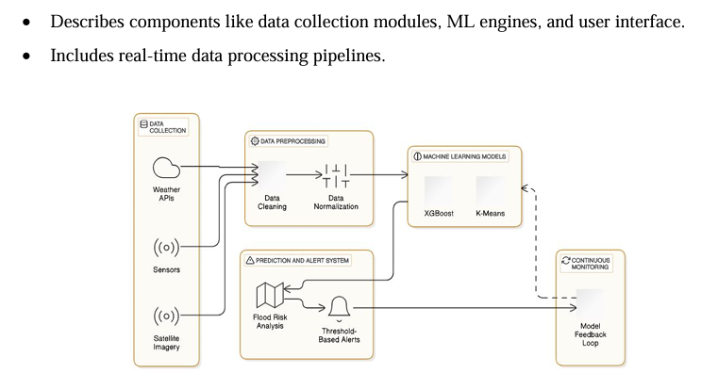
Architecture Diagram

Slide 11
Hardware and Software
Software
OS: Windows/Linux/MacOS
Programming Language: Python 3.8+
Key Libraries:
Machine Learning: xgboost, scikit-learn
Data Processing: pandas, numpy
Visualization: matplotlib, seaborn
APIs: requests
Assumptions:
• APIs (e.g., OpenWeather) are active and accessible.
•The dataset is clean and representative of real-world scenarios.
• Necessary permissions to access satellite data are in place.

Slide 12
Modules
Data Collection Module: Fetches real-time weather data (rainfall, temperature, humidity) via APIs (OpenWeather, NASA).
Retrieves historical flood records and satellite imagery.
Data Preprocessing Module: Cleans & normalizes data, handles missing values.
Balances imbalanced datasets using SMOTE/other techniques.
Extracts meaningful features for model input.
Model Training Module: Implements ML algorithms: XGBoost (supervised) & K-Means (unsupervised).
Performs hyperparameter tuning & cross-validation.
Flood Prediction & Risk Assessment Module: Analyzes real-time inputs and predicts flood likelihood.
Classifies areas into Low / Medium / High risk.
Provides confidence scores for predictions.

Slide 13
Conclusion
Summary and Impact
We successfully integrated satellite, tidal, and weather data to create a comprehensive dataset for flood analysis.
Through data cleaning and feature engineering, we prepared the data and defined a clear target for prediction.
Exploratory analysis has already revealed strong indicators of flood risk, like high humidity.
This project lays a solid foundation for building a highly effective, data-driven flood prediction model with the potential to save lives and reduce damages.

Slide 14
Github Link
The Github link provided should have public access permission.
Github Link
https://github.com/harshitha101831/Batch-number_131/upload

Slide 15
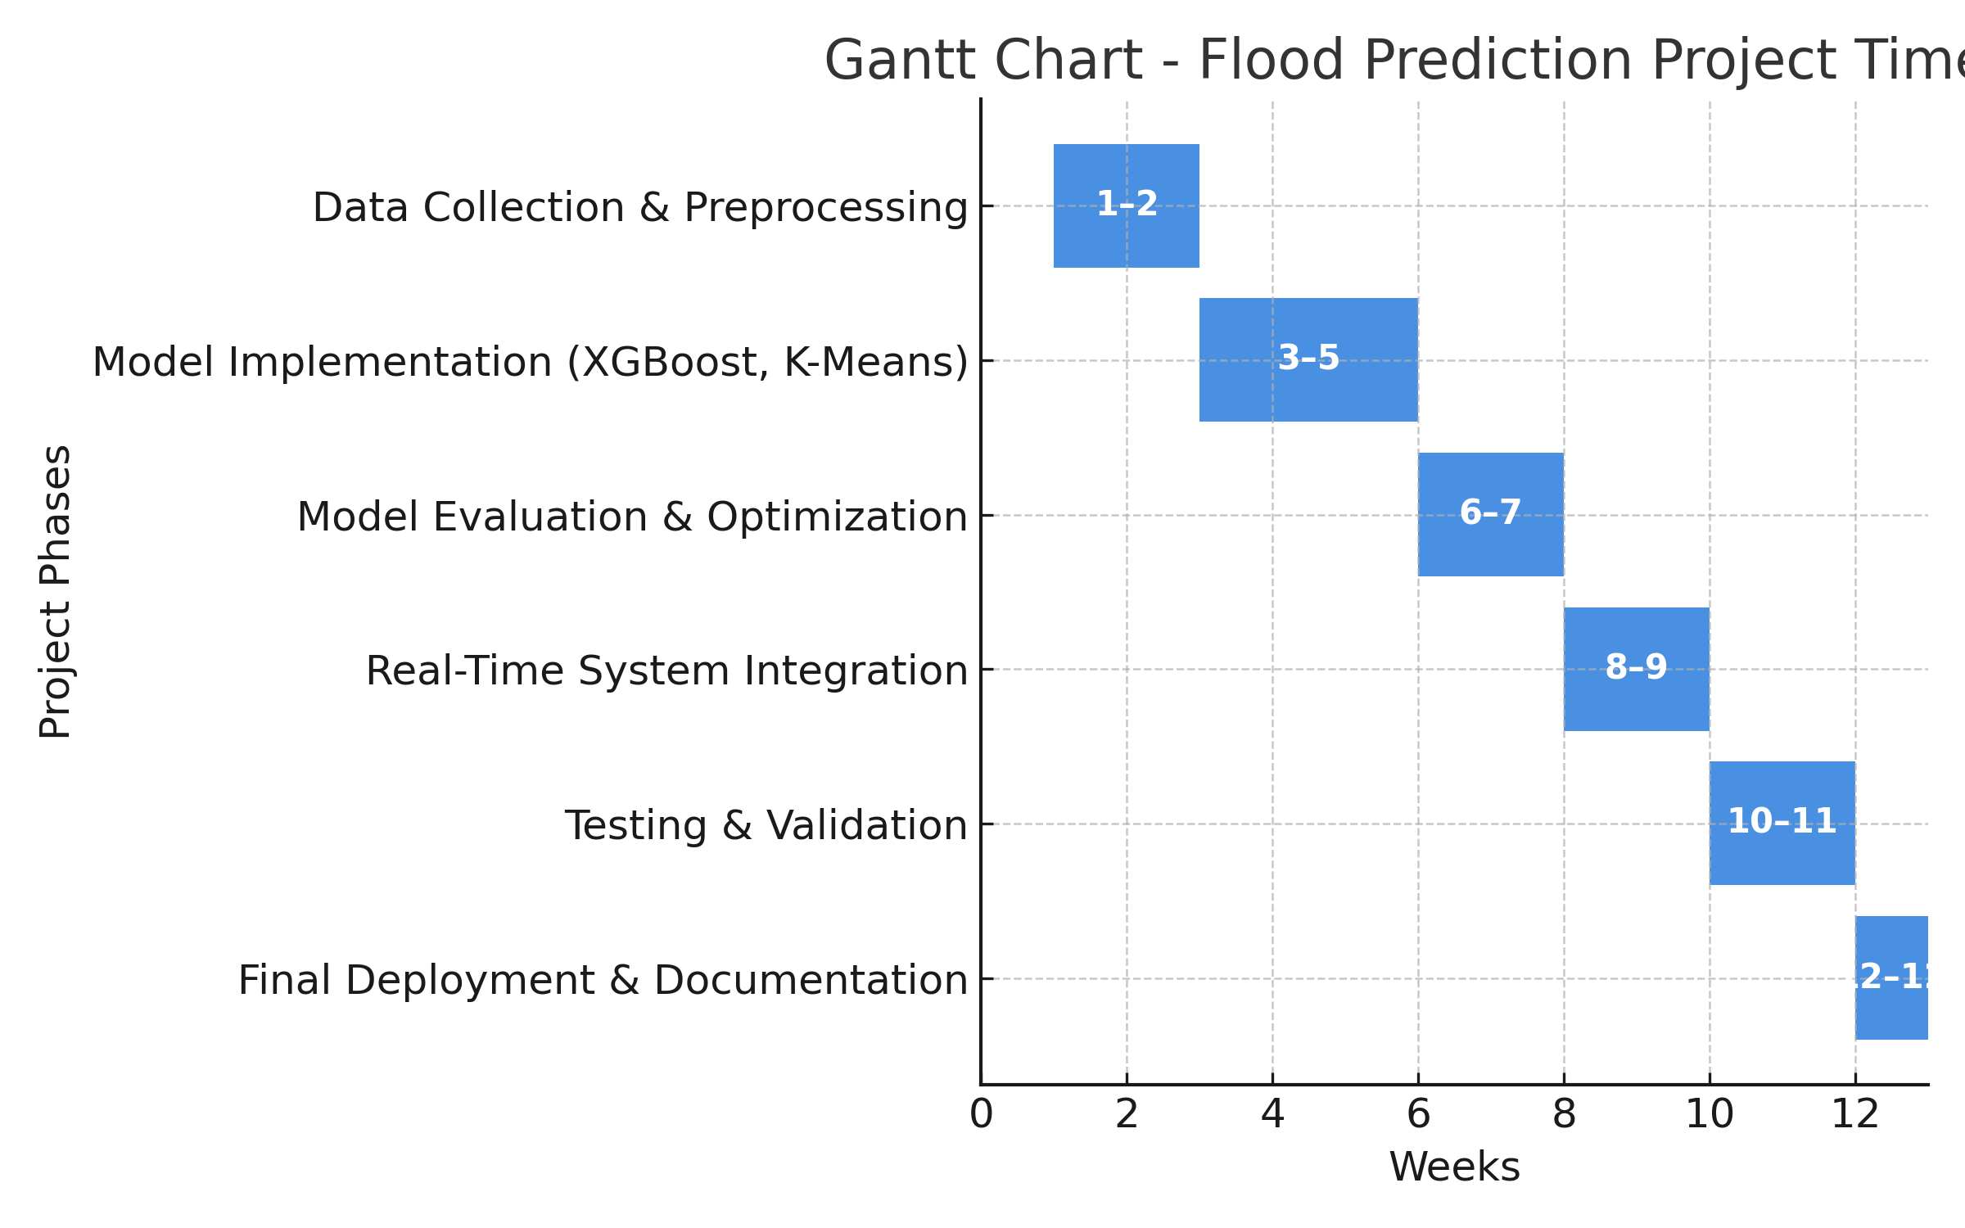
Timeline of the Project (Gantt Chart)

Slide 16
References (IEEE Paper format)
  .
[[1] M. Thomas et al., "A Framework to Assess Remote Sensing Algorithms for Satellite-Based Flood Index Insurance," in IEEE Journal of Selected Topics in Applied Earth Observations and Remote Sensing, vol. 16, pp. 2589-2604, 2023, doi: 10.1109/JSTARS.2023.3244098.
[2] S. H. Mahir et al., "Advanced Hydro-Informatic Modeling Through Feedforward Neural Network, Federated Learning, and Explainable AI for Enhancing Flood Prediction," in IEEE Open Journal of the Computer Society, vol. 6, pp. 726-738, 2025, doi: 10.1109/OJCS.2025.3556424.
[3]Y. Liu, L. Wang, S. Du, L. Zhao and X. Liu, "Flood Forecasting Method Based on Improved VMD-FOS-QR-RBL," in IEEE Access, vol. 11, pp. 4207-4218, 2023, doi: 10.1109/ACCESS.2022.3232405.
[4] J. Du et al., "Satellite Flood Assessment and Forecasts from SMAP and Landsat," IGARSS 2020 - 2020 IEEE International Geoscience and Remote Sensing Symposium, Waikoloa, HI, USA, 2020, pp. 3334-3337, doi: 10.1109/IGARSS39084.2020.9323552

Slide 17
[5] Y. Djenouri, M. Godziszewski, F. Andrade, G. Srivastava, A. N. Belbachir and A. Murano, "Game-Theoretic Consensus Deep Learning for Adaptive Flood Prediction in Digital Twin Environments," in IEEE Journal of Selected Topics in Applied Earth Observations and Remote Sensing, doi: 10.1109/JSTARS.2025.3596008.
[6]N. Akhtar et al., "Hierarchical Coloured Petri-Net Based Multi-Agent System for Flood Monitoring, Prediction, and Rescue (FMPR)," in IEEE Access, vol. 7, pp. 180544-180557, 2019, doi: 10.1109/ACCESS.2019.2958258.
[7] Z. Jiao, B. Chen, Z. Zhang and L. Wu, "Sample-Adjusted Threshold Calculation (SATC) for Optimizing Flood Mapping From a Trustworthy and Explainable Perspective," in IEEE Journal of Selected Topics in Applied Earth Observations and Remote Sensing, vol. 18, pp. 13622-13634, 2025, doi: 10.1109/JSTARS.2025.3572055

Slide 18
[8] P. Yang, X. Xu, M. Shao and Y. Liu, "Intelligent Prediction of Flood Disaster Risk Levels Based on Knowledge Graph and Graph Neural Networks," in IEEE Access, vol. 13, pp. 8416-8424, 2025, doi: 10.1109/ACCESS.2025.3525757.
[9] S. Puttinaovarat and P. Horkaew, "Flood Forecasting System Based on Integrated Big and Crowdsource Data by Using Machine Learning Techniques," in IEEE Access, vol. 8, pp. 5885-5905, 2020, doi: 10.1109/ACCESS.2019.2963819.
[10] D. H. Nguyen, X. Hien Le, J. -Y. Heo and D. -H. Bae, "Development of an Extreme Gradient Boosting Model Integrated With Evolutionary Algorithms for Hourly Water Level Prediction," in IEEE Access, vol. 9, pp. 125853-125867, 2021, doi: 10.1109/ACCESS.2021.3111287.

Slide 19


